Slide 1

Notes:
Hi I am karthik Section L, CSE. I’ll be presenting on recommender systems, which help users find content they like based on their interests. I’ll also discuss Udemy recommender system, which suggests courses to users based on what they’ve previously viewed or studied.

Slide 2
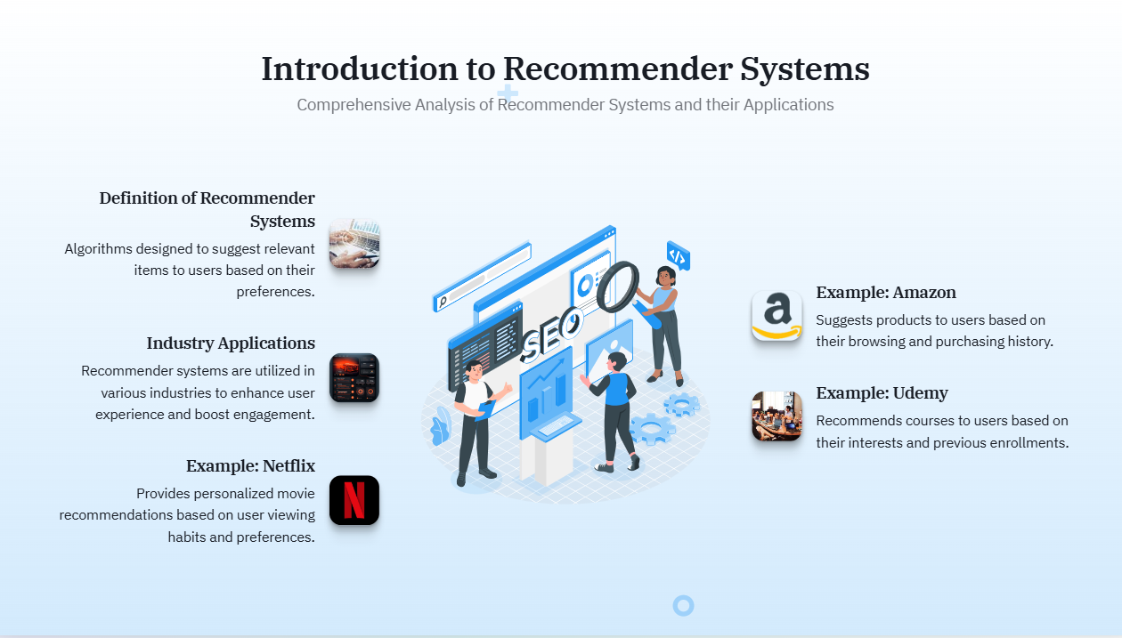
Notes:
What is a Recommender System? A tool that suggests items users may like, like movies, books, or courses, based on their interests.
Few significant features of recommendor systems are
Persermalization and engagement improves user engagement by catering to individual preferences
User Satisfaction Increases happiness by showing content that matches user preferences.
Content Recovery Brings back content users may have missed or overlooked.

Slide 3
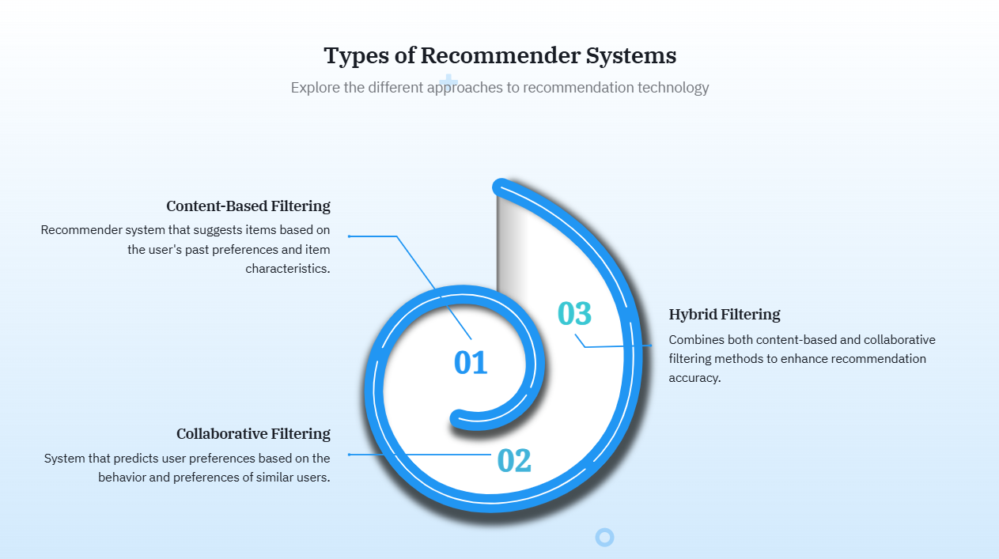
Notes:
There are 2 main types of recommendor systems
Content-Based Recommender Systems:
These recommend items based on what the user has liked before. For example, if someone enjoys action movies, the system will suggest more action films.
Collaborative-Based Recommender Systems:
These suggest items based on what similar users liked. If users with similar tastes enjoyed a certain movie, it will be recommended to others who haven’t seen it yet.
There is also another type ,
Hybrid Recommender Systems:
These combine both content-based and collaborative methods. This way, they can make better recommendations by using the best features of both systems.

Slide 4
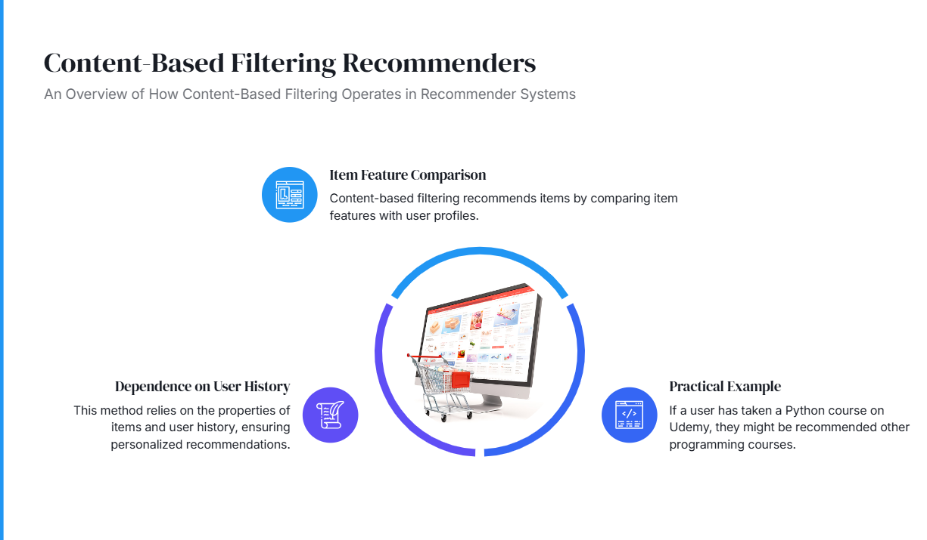
Notes:
Few key concepts in content in content based recommedr systems
1. Profile Building The system collects information about what users like, such as movies or books, to create a profile that reflects their interests.
2. Recommendation Process It compares the user profile to item features, scoring and ranking items to suggest what the user might enjoy next.
3. Applications Content-based recommenders are used in streaming services like Netflix, e-commerce sites like Amazon, and music platforms like Spotify to suggest relevant items.
4. New User Effectiveness New users may have limited data, so systems can ask for initial ratings or suggest popular items in the user’s preferred categories to help make recommendations.

Slide 5
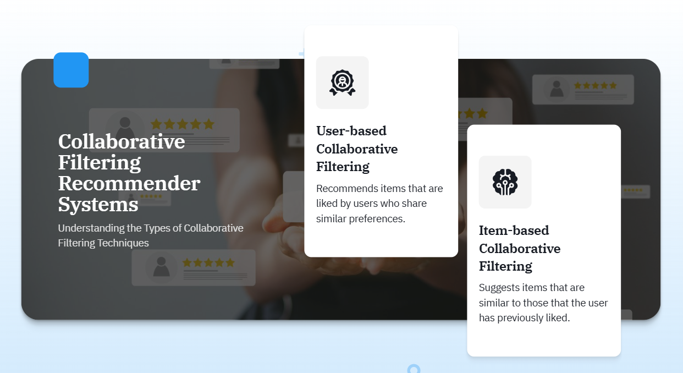
Notes:
Collaborative-Based Recommender Systems
The key features in collabrative recommendor system is
User-Based Filtering
User based filling refers it which it Recommends items based on what similar users have liked.
Item-Based Filtering
Item based filling Suggests items that are similar to those the user has previously enjoyed.
Use Cases in Platforms this is used in ,
Streaming: Netflix suggests shows watched by similar users.
E-commerce: Amazon recommends products bought by people with similar shopping patterns.
Social Media: Facebook suggests friends and groups based on shared connections.

Slide 6
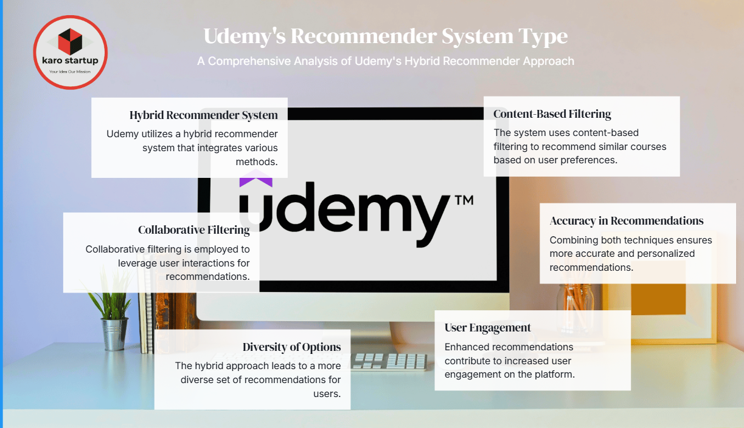
Notes:
Udemy uses hybrid recommender system. Udemy hybrid recommender system combines content-based and collaborative filtering. Content-based filtering suggests courses related to a user’s past choices, while collaborative filtering recommends courses enjoyed by similar users. This blend allows Coursera to provide personalized recommendations that fit each user’s interests. It helps both new and returning users find relevant courses easily.

Slide 7
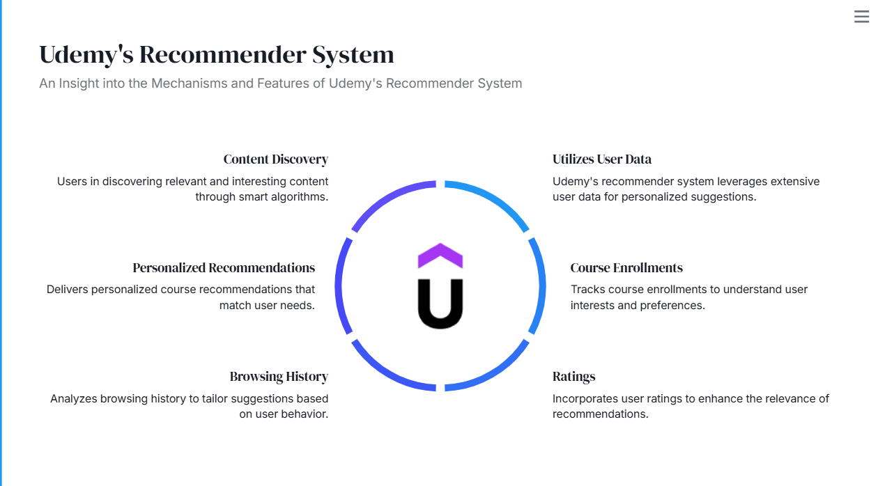
Notes:
Udemy recommender system uses four main types of data to provide personalized suggestions through a mix of content-based and collaborative methods:
User data:refers to Information about each user’s interests and educational background, used for content-based recommendations.
Personailized recommendation : collects Data from similar users’ interactions, helping with collaborative recommendations.
User History: Tracks each user’s actions, like search history and viewed courses, to improve content-based recommendations.
Course Enrollement: contains Information about each course, including subject and ratings, supporting both content and collaborative methods.
Udemy categorizes courses by subject, skill level, and tags such as 'beginner, 'programming;'business, etc. The system then recommends courses that match the user's previously completed or enrolled courses. If a user has taken courses in web development and SEO Udemy's recommendation system might suggest related topics like JavaScript frameworks or digital marketing.
Using these datasets together make Udemy recommendations accurate and personalized.

Slide 8

Notes:
The algorithms are used in Udemy recommender system are cutting edge like matrix factorization and deep learning
using NLP, Udemy's recommendation system can extract key topics, themes, and sentiment from course descriptions and user reviews. It matches these with the user's preferences, behavior, and goals to recommend more relevant courses.

Slide 9
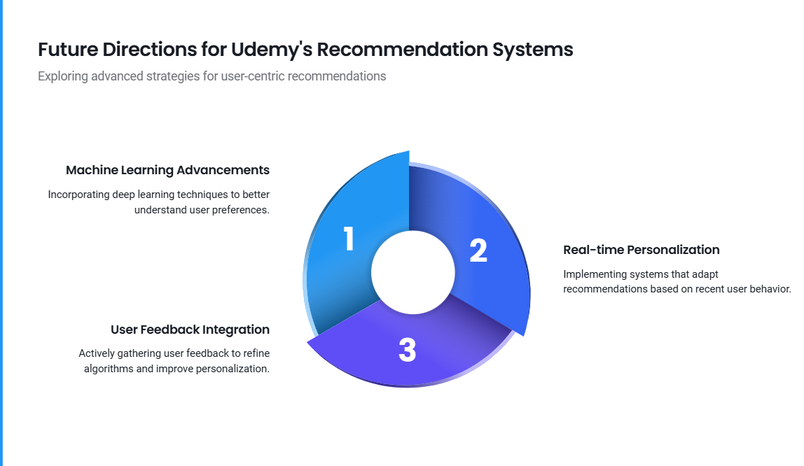
Notes:
Real-Time Adaptation: The system will adjust instantly based on what users are learning, offering suggestions that fit their current progress and choices.

Slide 10
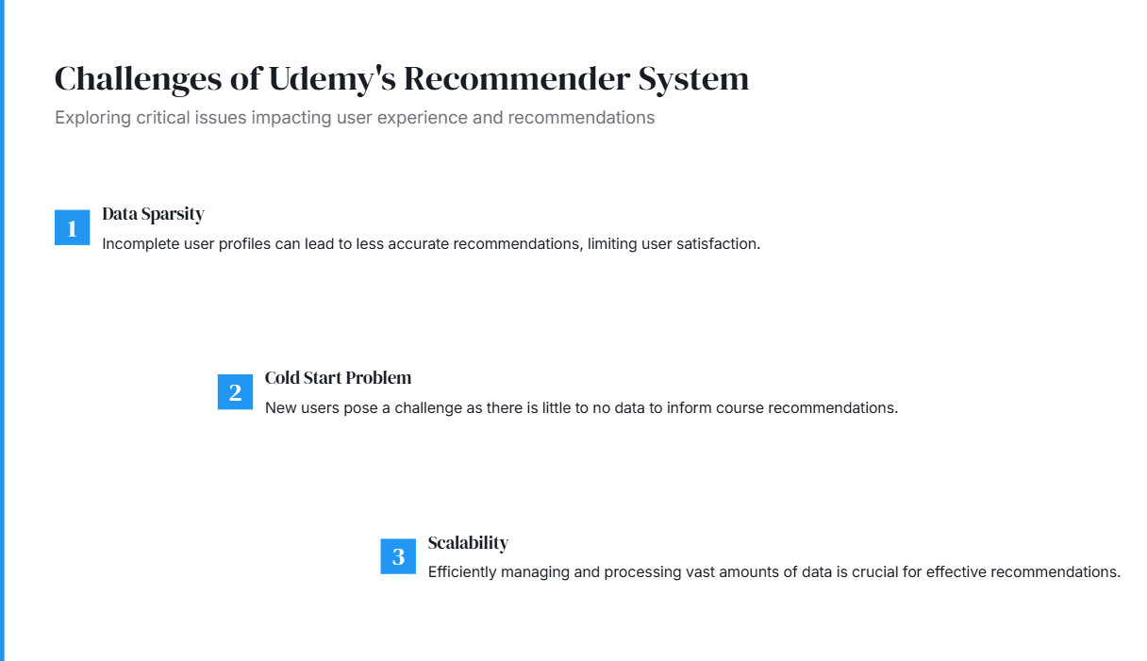
Notes:
Diverse User Base: Coursera has a wide range of users with different backgrounds, interests, and learning goals. This diversity makes it challenging to create recommendations that appeal to everyone.
Cold Start Problem: New users often lack sufficient data for the system to provide accurate recommendations. Since they haven’t taken any courses or provided feedback, it can be difficult for the system to understand their preferences.
Over-Personalization: If the system becomes too focused on individual preferences, it might limit exposure to new or diverse courses. Users may miss out on valuable learning opportunities that are outside their usual interests.
Addressing these challenges is crucial for improving the effectiveness of Udemy recommender system and ensuring a positive learning experience for all users.

Slide 11
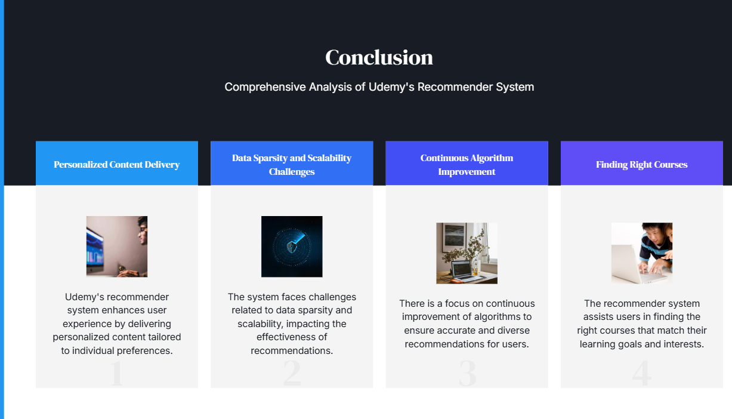
Notes:
Conclusion : Udemy’s recommendation system is a critical component in creating a personalized and engaging learning experience for millions of users worldwide. By leveraging collaborative filtering, content-based filtering, deep learning models, and behavioral data, Udemy can provide learners with highly relevant course recommendations. This helps improve course discovery, boosts engagement, and drives higher course enrollment and completion rates. Continuous refinement of the recommendation algorithms ensures that Udemy’s platform remains a leading destination for online learning.

Slide 12

Notes:
Thank u!!!!

